Slide 1
DAODAS Updates
Prevention Quarterly Meeting
November 7, 2019

Slide 2
SABG FY20-FY21
Application-due October 1, 2019
Report-due December 2, 2019
Synar Report- due December 31, 2019
Once submitted, reviewed by CSAT and CSAP Project Officers
Feedback is provided and State makes corrections/additions
Application is approved
Reports are accepted
Funding is released to the State

Slide 3
SABG Application FY20-FY21
https://www.daodas.sc.gov/about/sabg-application/
Part 1- State Information and Certifications
Part 2- State Information and Certifications (continued)
Part 3 and 4 Strengths and organizational capacity of the service system

Slide 4
SABG Application FY20-FY21
Part 5-Unmet needs and gaps (needs assessment)

Slide 5
SABG Application FY20-FY21
Part 6- Quality and Data Collection Readiness
Prevention Priorities are 1, 2,3 and 5

Slide 6
SABG Application FY20-FY21
Part 7-Financial tables and additional information
Table 2, 3, 4
Table 5a,5b,5c,(prevention set-aside)
Table 6
#8-Primary Prevention: Addresses the SPF -Assessment, Capacity, Planning, Implementation and Evaluation

Slide 7
SABG Report FY20-Reporting on FFY 2017
Table 1: State Priorities
Your CSAP SPO will be reviewing the state’s substance abuse prevention (SAP) priorities. States must report progress on the substance abuse prevention priorities listed in their FFY 2018-2019 plan (second year target). If a goal was not achieved, your state should provide a description of why the goal was not met, and steps proposed to meet the goal.
Table 2: State Agency Expenditure Report
The time period for this table is 7/01/18-06/30/19. The time period for this table is NOT the FFY 2017 SABG expenditure period. Therefore, this is NOT the table that your CSAP SPO will be using to ensure that at least 20% of the state’s FFY 2017 SABG expenditures were for primary prevention.

Slide 8
SABG Report FY20-Reporting on FFY 2017
Table 4: State Agency SABG Expenditure Compliance Report
The time period for this table is 10/01/16-09/30/18, which is the expenditure period for the FFY 2017 SABG award.
This table is used by your CSAP SPO to ensure that at least 20% of your state’s FFY 2017 SABG expenditures were for primary prevention.
Tables 5a and 5b: Primary Prevention Expenditures Checklist and Primary Prevention Expenditures by IOM Category
The time period for these two tables is 10/01/16-09/30/18, which is the expenditure period for the FFY 2017 SABG award.
States must complete either Table 5a or Table 5b. While states can complete both tables, completion of both tables is not required.

Slide 9
SABG Report FY20-Reporting on FFY 2017
The amounts reported in Tables 5a and 5b should be limited to expenditures for primary prevention programs and should exclude expenditures for prevention resource development. Expenditures for prevention resource development should be reported in Table 6.
Table 5c: SABG Primary Prevention Priorities and Special Population Categories
This table is used by your CSAP SPO to identify the categories of substances and the populations your state targeted with FFY 2017 SABG primary prevention set-aside funds.

Slide 10
SABG Report FY20-Reporting on FFY 2017
Table 6: Resource Development Expenditure Checklist
The time period for this table is 10/01/16-09/30/18, which is the expenditure period for the FFY 2017 SABG award.
States may utilize either SABG administration funds OR primary prevention set-aside funds for prevention resource development.
Table 7: Statewide Entity Inventory
The time period for this table is 10/01/16-09/30/18, which is the expenditure period for the FFY 2017 SABG award.
Your CSAP SPO will be reviewing this table to ensure that your state has reported primary prevention expenditures by funded entity.

Slide 11
SABG Report FY20-Reporting on FFY 2017
Table 9: Prevention Strategy Report
The time period for this table is 10/01/16-09/30/18, which is the expenditure period for the FFY 2017 SABG award.
Your CSAP SPO will be reviewing this table to ensure that your state has reported activity codes for each of the six required primary prevention strategies.
Tables 21-30: Performance Indicators and Accomplishments
For most states, the data for these tables will be pre-populated. (National Outcome Measures from the National Household Survey on Drug Use and Health-NSDUH)

Slide 12
SABG Report FY20-Reporting on FFY 2017
Tables 31-34: Performance Indicators and Accomplishments
For these tables, states should report on calendar year 2017.
For Tables 31 and 32, states should ensure that the total number of people served in each demographic category (age, gender, race, and ethnicity) all match (e.g., if the total number of people served of all ages equals 1000, then the total number of men, women, and gender unknown people served should also equal 1000).
Table 35
The time period for this table is 10/01/16-09/30/18, which is the expenditure period for the FFY 2017 SABG award.
States should ensure that the total amount of dollars spent on evidence-based prevention programs does not exceed the total amount of dollars spent on primary prevention on Table 4.

Slide 13
Synar Report FFY20
The Annual Synar Report (ASR) format provides the means for states to comply with the reporting provisions of the Public Health Service Act (42 U.S.C. 300x-26) and the Tobacco Regulation for the Substance Abuse Prevention and Treatment Block Grant (SABG) (45 C.F.R. 96.130 (e)).
In accordance with the tobacco regulations, states are required to provide detailed information on progress made in enforcing youth tobacco access laws (FFY 2019 Compliance Progress) and future plans to ensure compliance with the Synar requirements to reduce youth tobacco access rates (FFY 2020 Intended Use Plan). These data are required by 42 U.S.C. 300x-26 and will be used by the Secretary to evaluate state compliance with the statute.

Slide 14
Synar Report FFY20
What is required:
FFY 2020 Synar Survey Results
Synar Inspection Form
Synar Inspection Protocol
A scanned copy of the signed Funding Agreements/Certifications
PUBLIC HEALTH SERVICES ACT AND SYNAR AMENDMENT
42 U.S.C. 300x-26 requires each state to submit an annual report of its progress in meeting the requirements of the Synar Amendment and its implementing regulation (45 C.F.R. 96.130) to the Secretary of the Department of Health and Human Services. By signing below, the chief executive officer (or an authorized designee) of the applicant organization certifies that the state has complied with these reporting requirements and the certifications as set forth below.
SYNAR SURVEY SAMPLING METHODOLOGY
The state certifies that the Synar survey sampling methodology on file with the Center for Substance Abuse Prevention and submitted with the Annual Synar Report for FFY 2020 is up-to-date and approved by the Center for Substance Abuse Prevention.
SYNAR SURVEY INSPECTION PROTOCOL
The state certifies that the Synar Survey Inspection Protocol on file with the Center for Substance Abuse Prevention and submitted with the Annual Synar Report for FFY 2020 is up-to-date and approved by the Center for Substance Abuse Prevention.

Slide 15
Other DAODAS Updates
Data Resources
CTC
PREP
TEP
SYNAR/STEP
Tobacco Challenge
SOR opioid funding
IMPACT

Slide 16
Communities That Care Survey
Sazid sent each of you (or your respective CTC survey representative) an email individually, last week.
If you (or your respective rep.)have not already responded to that email, please respond as soon as you can
regarding the current status of your recruitment of schools for the survey in your county.
Reminder that you have until the beginning of December to get those survey to intent forms and contact lists in to
us so we can hand them off to our surveying vendor to get their implementation process going.
If you need any sort of extension, please let Sazid know asap. If you have any questions please respond
to his email or give him a call, he is happy to assist any way he can, thanks for all of your efforts,
this survey will be a success because of it! =)
Sazid Khan, PhD, MPH
State Epidemiologist
Research and Evaluation 1801 Main Street, 4th Floor, Columbia, SC 29201
Email: SKhan@daodas.sc.gov
Office:(803)896-1182

Slide 17
PREP
PREP Committee is reviewing curriculum and materials to ensure it meets the requirements of the “Responsible Alcohol Server Training Act” (S342)
Timeline- Complete update and training for field by Spring 2020
Materials that have been ordered for County agencies:
The SUM-IT-CUP® (Standard Unit of Measure) Complete is an alcohol educational tool designed to allow adults, 21 years of age and older, to pour and measure a volume of liquid and determine the number of standard drink units represented by the liquid for various types of popular alcohol beverages.
https://www.fatalvision.com/product/sum-it-cup-complete-with-master-bartender/
Retractable “You Call The Shots” tabletop banner is 32″ wide x 40″ high and comes standard with a protective carrying bag.
https://www.fatalvision.com/product/you-call-the-shots-tabletop-banner/
Other materials or information to consider as curriculum is updated?

Slide 18
TEP
Current TEP Committee members:
Ashley Bodiford
Jeff McAninch
Amands Davis
Veronica Edmonds
Joe Pinilla
Caroline Grant
Saundra Wigfall-Brown

Slide 19
What units of the Stanford Tobacco Prevention Toolkit are included in the TEP curriculum?
The program utilizes:
Two Truths and a Myth
A Little History to Set the Stage
E-Cigarette and Vape Pens 101
What’s in E-Cigarettes and Vape Pens
Pod-Based Systems
Unit-1-Brain-101
The Stanford Tobacco Prevention Toolkit includes lessons (with talking points), PowerPoints, worksheets, and activities which cover an array of topics from a history of tobacco products to the emerging public health threat of young electronic cigarettes users.
Notes:
The Stanford Tobacco Prevention Toolkit training was intended to give you an overview of what is in the Toolkit, how to use it, etc. All of the information, materials, and talking points are there for you to go and deliver this information. The new TEP curriculum contains 85% of the Stanford Tobacco Prevention Toolkit material from these six units.

Slide 20
How can you utilize TEP and/or the Stanford Tobacco Prevention Toolkit?
Use of Stanford Tobacco Prevention Toolkit
If you attended the Stanford Tobacco Prevention Toolkit (STPT) Training, then you are free to share the STPT materials and do TOTs with parents, teachers, law enforcement, etc. for the STPT. That is part of what the STPT Training is intended for.
TEP Facilitation or Aspiring TEP Trainer-of-Trainers
If you need more TEP training after reading the manual, reviewing the curriculum, and attending the STPT training, the TEP Committee will continue to provide more in-depth technical assistance. Therefore, DAODAS strongly encourages TEP facilitators to reach out to their Regional TEP Committee member(s) to ensure that they are teaching the curriculum with fidelity. DAODAS recommends the TEP facilitator to schedule a TOT with their Regional TEP Committee member to become a TEP TOT.
Notes:
I strongly encourage you to contact your regional TEP Committee members and your Regional Capacity Coach if you have questions.
If you didn't attend the STPT Training, then it is mandatory for you to contact the TEP Committee to receive the necessary training as well as receive your agency’s TEP binder and TEP flash drive). DAODAS encourages their Regional Capacity Coaches help TEP Committee members provide additional TEP training or TEP TOT training.

Slide 21
How do I enter these activities into Impact?
Program Title | Program Description | Program Type | Primary Strategy | Note
Stanford Tobacco Prevention Toolkit Information /Education / Awareness | Media Campaigns; training for targeted populations; information dissemination for targeted population; and printed materials. | Local/ Innovative | Information Dissemination | If you choose to group information dissemination strategies into a single program, be sure to select all objectives that apply and enter all relevant program outcomes.
Stanford Tobacco Prevention Toolkit: Modules for tobacco and nicotine education | Multi-session evidence-based curriculum delivered consecutively to individuals within a population. Must use the DAODAS Standard Survey (Pre- and Post-Test) | Evidence-based | Education | Evidence-based curriculum titles are listed in the Evidence-Based drop down menu
Tobacco Education Program (TEP) | Problem ID & Referral educational program for substance use | Local/ Innovative | Problem ID & Referral | If you group problem ID and referral strategies into a single program, be sure to select all objectives that apply and enter all relevant program outcomes.
Notes:
You have three choices: 1) Information Dissemination, 2) Recurring Education Program, and/or 3) Problem Identification and Referral (TEP).

Slide 22
SYNAR/STEP
The biggest change in the Annual Synar Study is the implementation timeframe. This used to be January 1 – February 28. But, the new study timeframe will take place between November 1 – January 15 or March 1 – May 15. This is dependent upon which group you are randomized into (i.e., Group 1 or Group 2) each year. FY21 groups are below.
Group 1: Region 4 and Region 1 are November 1 – January 15.
Paperwork must be mailed to DAODAS by February 1.
Group 2: Region 2 and Region 3 are March 1 – May 15.
Paperwork must be mailed to DAODAS by June 1.

Slide 23
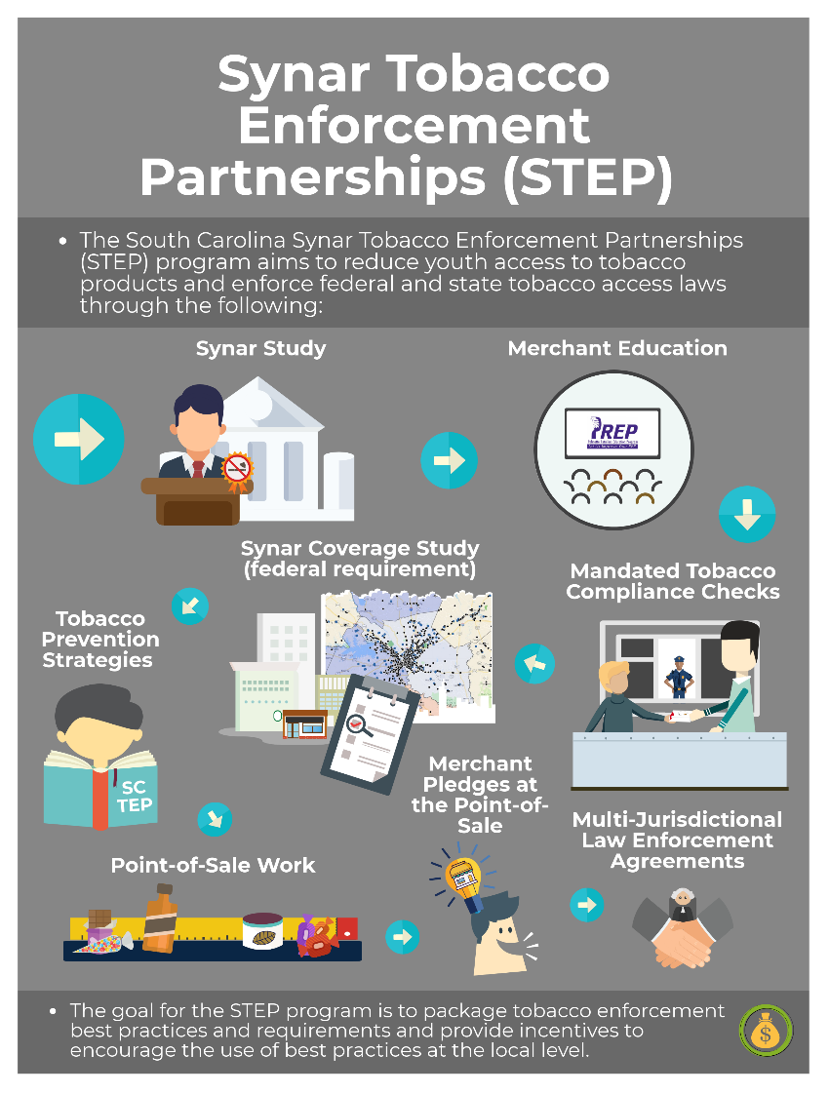
What is Synar Tobacco Enforcement Partnerships (STEP)?
STEP aims to reduce youth access to tobacco products and enforce state and federal access laws through tobacco prevention best practices.
STEP is an incentive program that financially rewards the local alcohol and drug abuse authority prevention staff for their efforts.
STEP has been revamped for FY20!

Slide 24
Tobacco Challenge
From E-mail:
Per our discussion at the last AET Coordinator’s meeting on September 26th, please see attached the tobacco challenge memo that you should share with your law enforcement and prevention partners. We are excited about issuing this challenge and look forward to seeing/hearing all about your circuit’s efforts during the challenge to raise awareness on the tobacco/vaping issues with adolescents in our state.
Additionally, please see attached and share with your partners the social media content that has been developed by our partners at Chernoff Newman for you to use during the challenge period. DAODAS also recently purchased and sent out to each of the 32 agencies the following vaping materials:
https://nimcoinc.com/product/the-vaping-epidemic-table-top-retractable-banner/
https://nimcoinc.com/product/dangers-of-vaping-marijuana-table-top-retractable-banner/
https://nimcoinc.com/product/juuling-table-top-retractable-banner/
https://www.journeyworks.com/Vaping-Set-of-11/productinfo/1117/100/

Slide 25
To earn a South Carolina Tobacco-Free Challenge 2019 coin, an officer or prevention partner must complete and properly document at least four of the following service activities (resulting in at least eight hours of service) between October 15 and December 1, 2019, to prevent underage age tobacco use and save lives in their communities:
Coordination of enforcement/education (key officers and/or prevention partners who coordinate at least four enforcement or education operations).
Enforcement of smoke-, tobacco-, and/or vape-free policies at school-related events.
Working with colleges/universities or school boards, principals, or districts (i.e., superintendents) to review and update school grounds policies, following the standards of model school policies (https://www.smokefreesc.org/model-policies).
Conducting compliance checks, to include vaping devices, e-cigarettes, and traditional tobacco products (a total of at least 10 checks and/or two hours of service time).
Co-leading a PREP (i.e., merchant education) class (at least two hours of service time).
Providing community health fairs or speaking engagements/presentations (school assemblies, church/community events, etc.) for at least two hours of service time (e.g., two one-hour assemblies at two schools).
Coordinating a youth-led video production contest to be shown to a student body during November about the dangers of smoking, chewing, vaping, etc.
Working with a youth advisory board or school club to provide “Tobacco-Free/Vape-Free Promise” activities such as awareness events, promise/pledge events, school spirit week activities, etc.
Utilizing media (including social media) to provide awareness of the issue and/or enforcement operations, to consist of coordination of at least two of the following activities:
convening a press conference and/or ride-along with local media;
utilizing FaceTime Live or other social media platform to bring about awareness of the issue;
publishing a feature article/editorial in a newsletter/newspaper;
creating and advertising a photo filter for Instagram; and/or
utilizing social media resources provided by DAODAS and consistent posting throughout the challenge period on social media platforms.

Slide 26
SOR Opioid One Time Funding
DAODAS will conduct quarterly reviews of budget spending. If budget is not spent in a timely manner, funds could be reduced up to 10%.
The one-time sub-grant award period is July 1, 2019-June 30, 2020
Implement a minimum of two pre-approved opioid prevention strategies in each county. In addition, funds can also be utilized to build capacity of agency staff and local government partners.
Complete the Quarterly Implementation & Finance Report for each county (submit in Box Enterprise). Due dates are: October 31, 2019; January 31, 2020; April 30, 2020; and July 31, 2020.
Time can be entered into IMAPCT under Administrative Time-there is a code for SOR
Up to 15% can be moved from one line category to another without approval

Slide 27
SOR One-Time Prevention Funding
Capacity: Funds can be utilized to build capacity of agency staff and local government partners. Funds can be budgeted to cover travel to attend state and national conferences (listed below).
National Association of Drug Diversion Investigators Conference (November 13-15, 2019) https://www.naddi.org/events/2019-naddi-30th-anniversary-conference/
CADCA Leadership Forum (February 3-6, 2020)
National Rx Drug Abuse and Heroin Summit (April 13-16, 2020) https://www.rx-summit.com/
CADCA Mid-Year Training Institute (July 26-30, 2020)
South Carolina Governor’s Opioid Summit (September, 2020)
Interest in attending a conference not listed above requires approval from DAODAS.
Tall Cop training-December 13, 2019 is approved for use of funds

Slide 28
IMPACT
Follow guidance and Instructions for FY19 Close-out and FY20 Set-up
Make sure all mid-year and year end objectives have been entered on the activities page

Slide 29
Questions?

